Slide 1
Visualizing Data Scientist or Machine Learning Jobs in Canada
By Roger Chow

Slide 2
PROEJCT OBJECTIVE
Most of us will be completing the Masters program this year. Most of us will likely be searching for a career as a data scientist. Most of us will probably be job sites like INDEED.COM.
Where are all the data scientist jobs
Who’s hiring
What are they paying
What are the qualifications

Slide 3
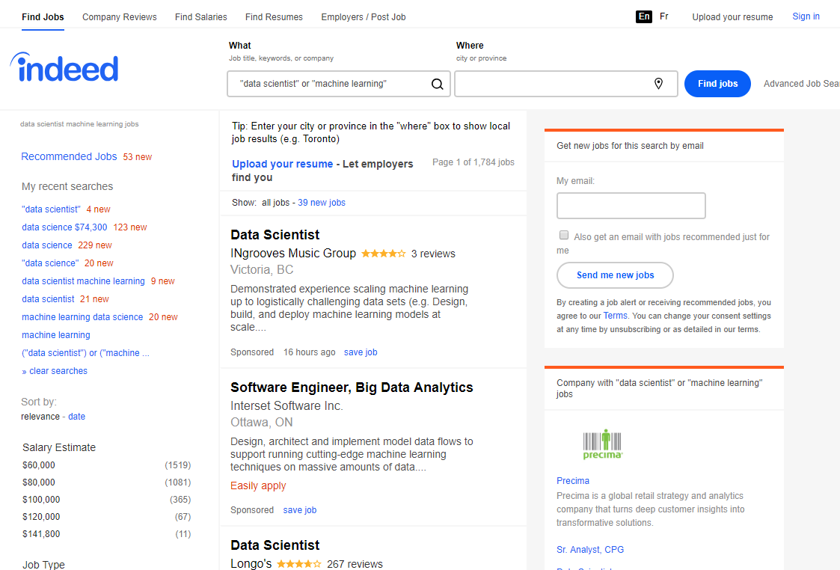
SOURCE DATA
Data is scraped from CA.INDEED.COM using BeautifulSoup

Slide 4
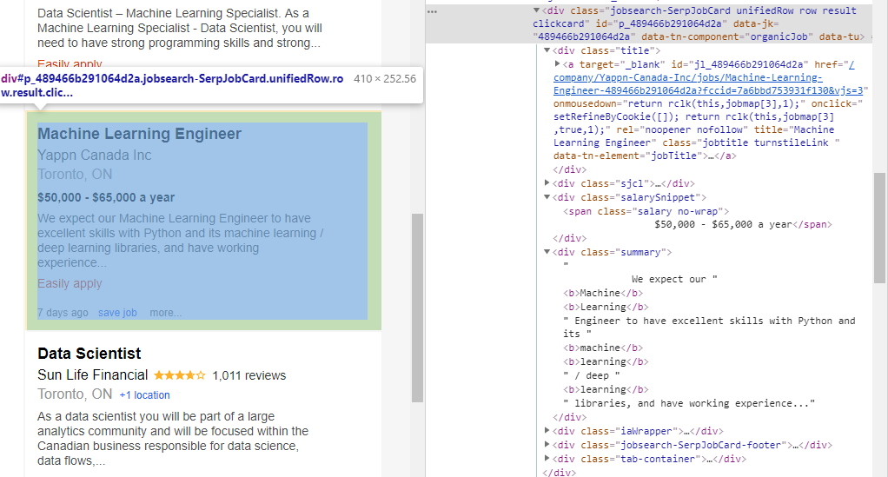
SOURCE DATA – Level 1
Job Link
First level
Salary
Summary
Sponsored

Slide 5
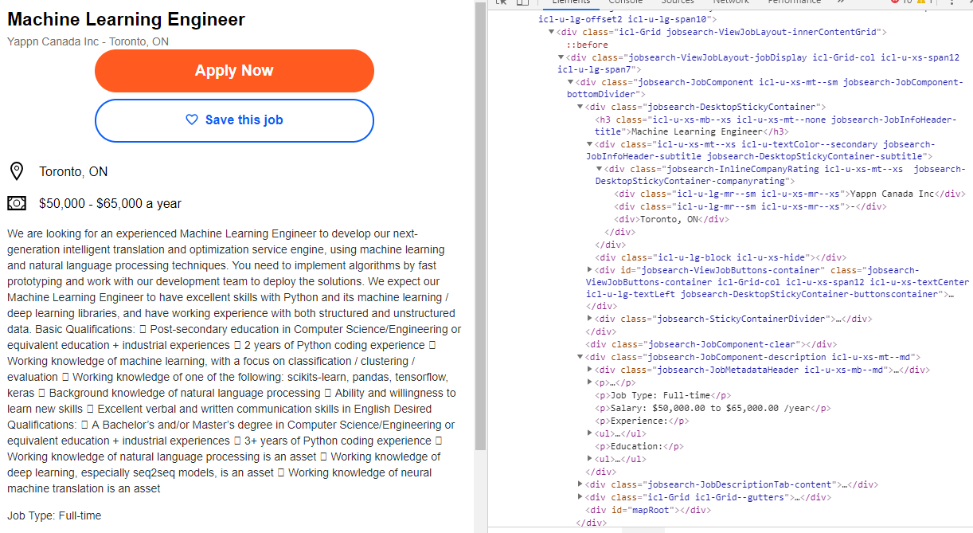
SOURCE DATA – Level 2
Job Title
Company
Posting

Slide 6
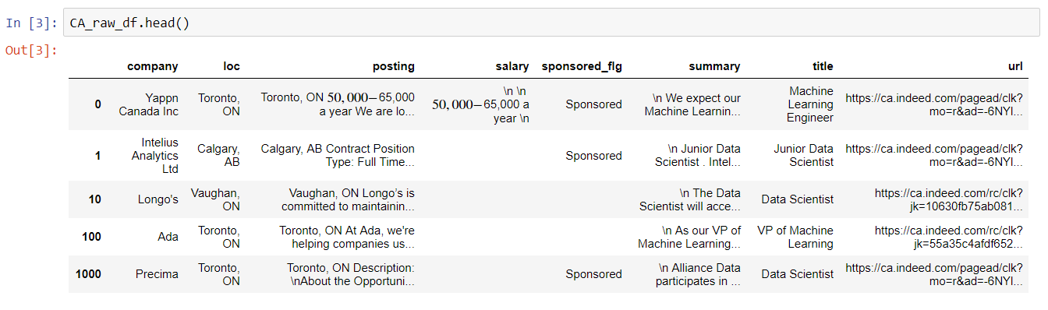
PREPROCESSING
Standardize Text
Split City and Province
Extract Mean Salary

Slide 7
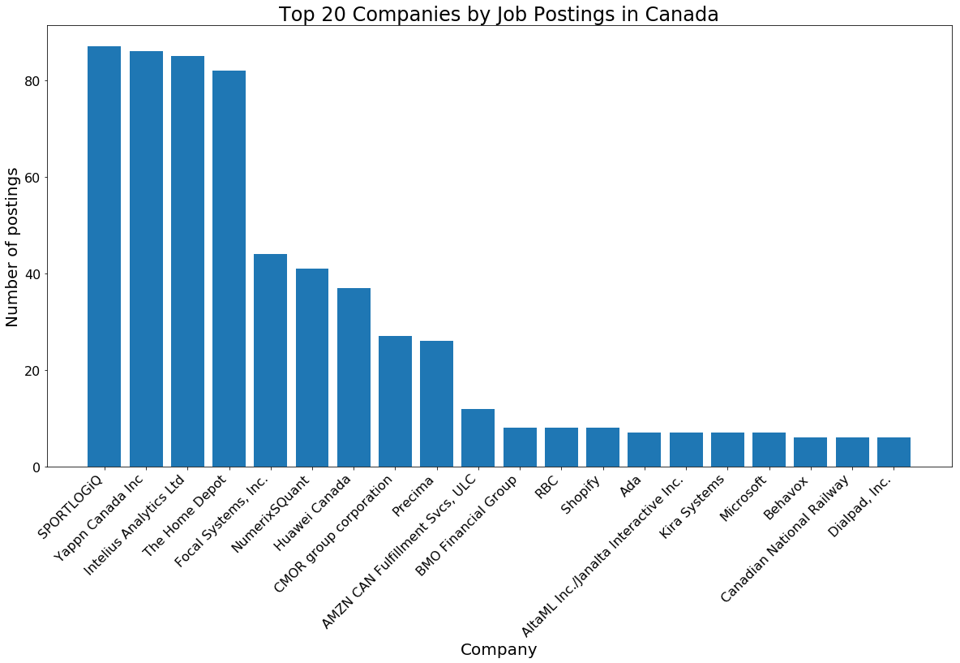
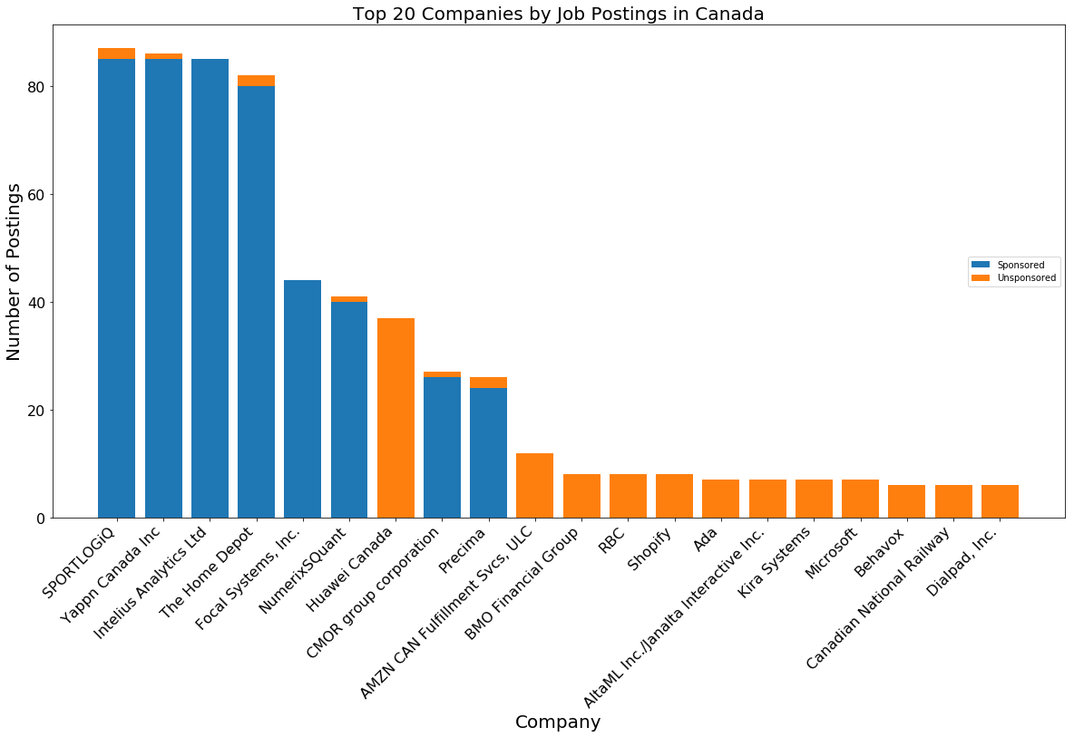
PREPROCESSING (cont.)
Remove duplication
Handling sponsored jobs

Slide 8
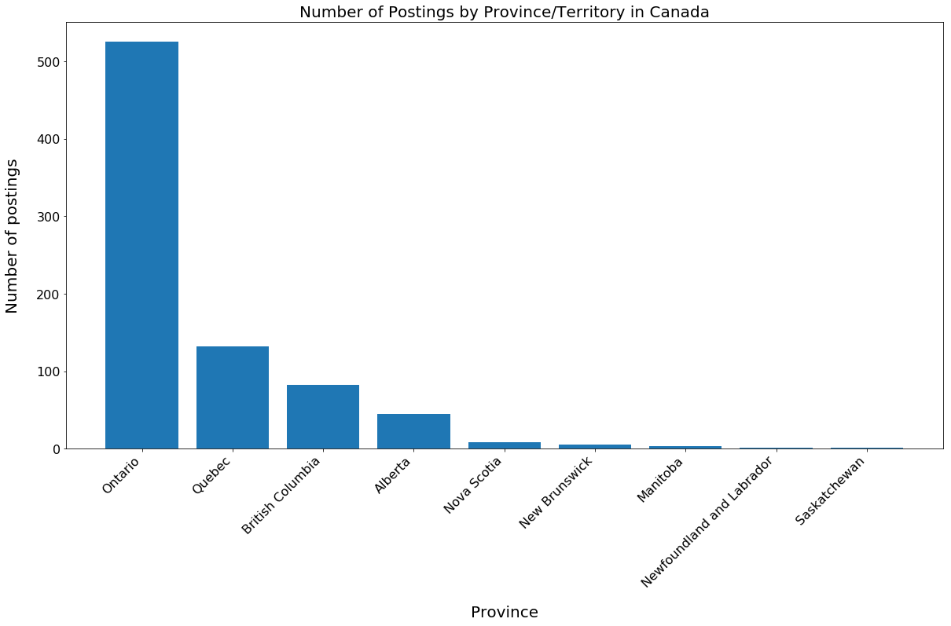
WHERE ARE ALL THE JOBS?
Ontario

Slide 9
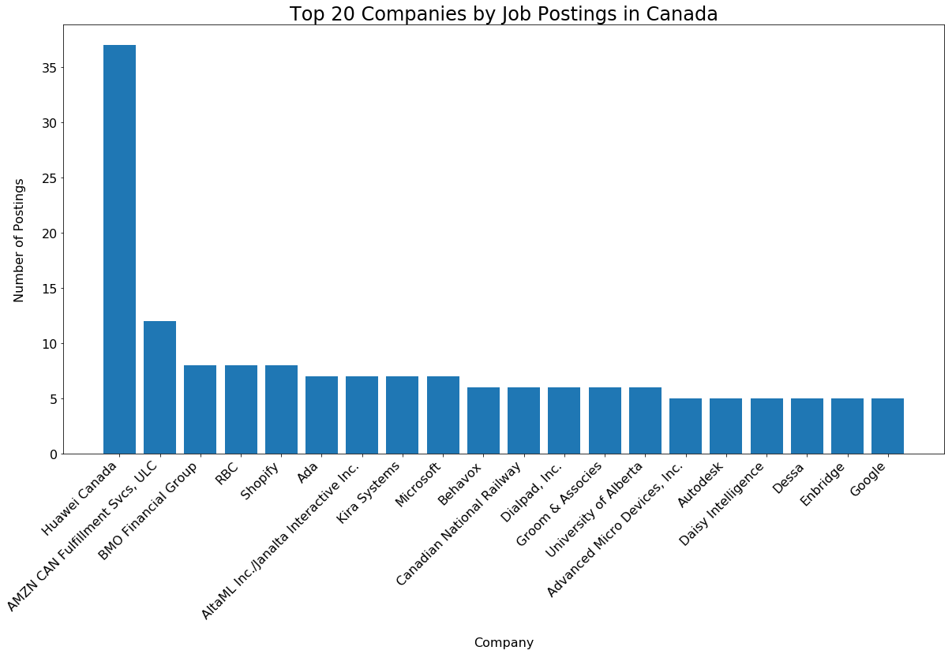
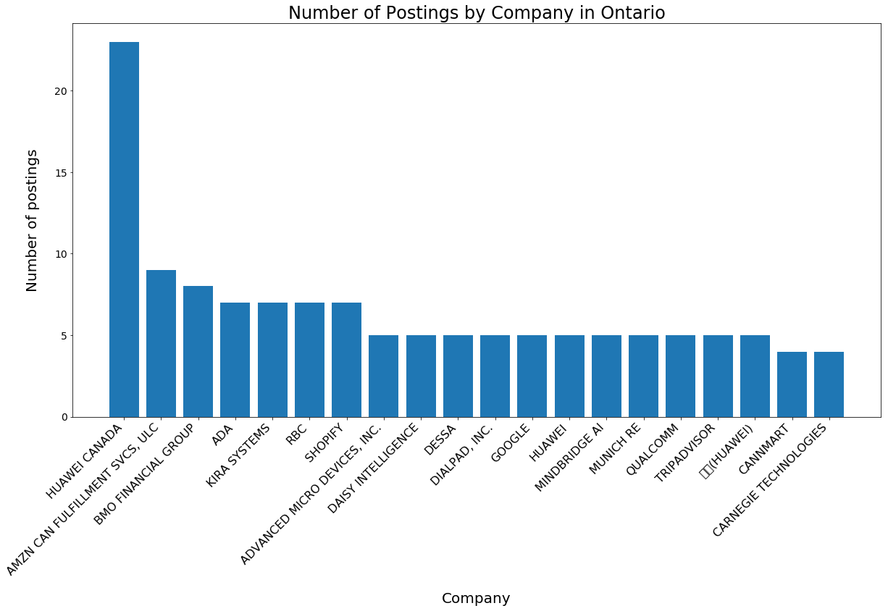
WHO’S HIRING?
Huawei Canada
Amazon Fulfillment Services
BMO Financial
RBC

Slide 10
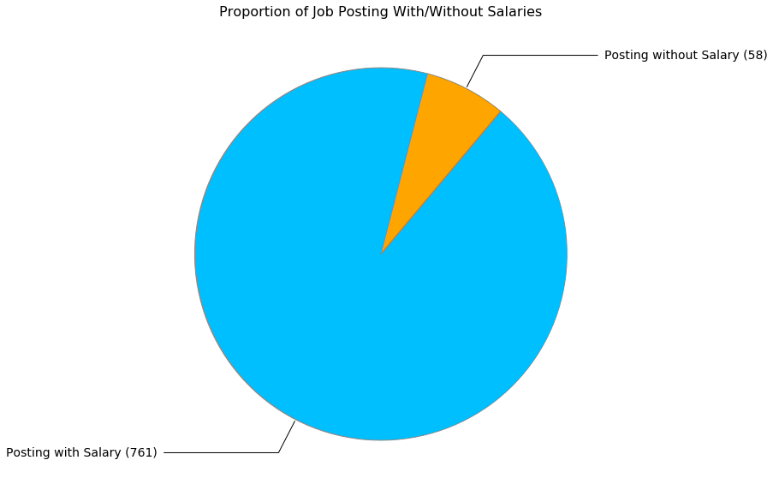
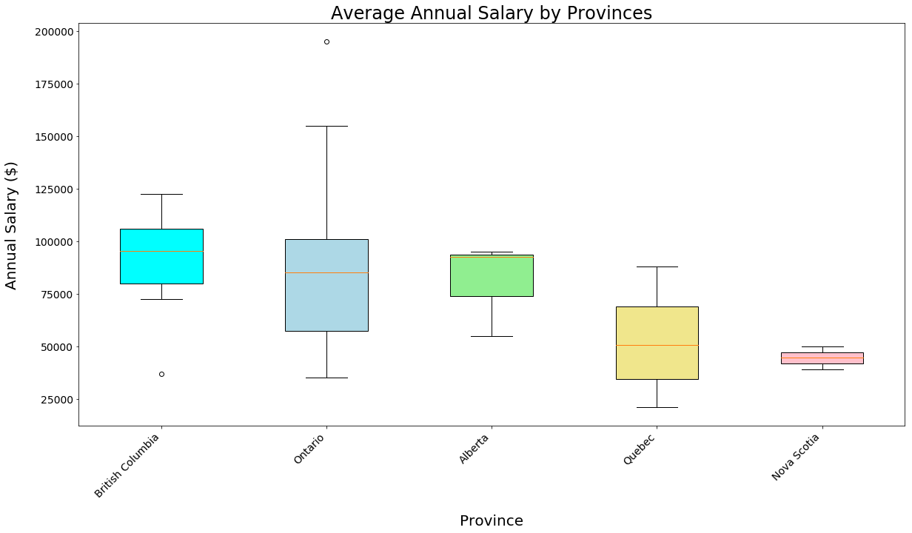
WHAT ABOUT SALARY?

Slide 11
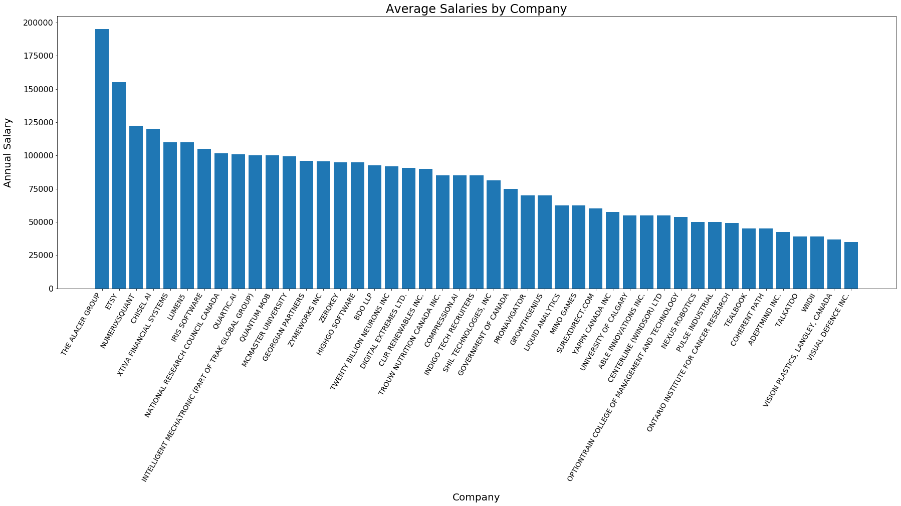
WHAT ARE THEY PAYING?
$100 K

Slide 12
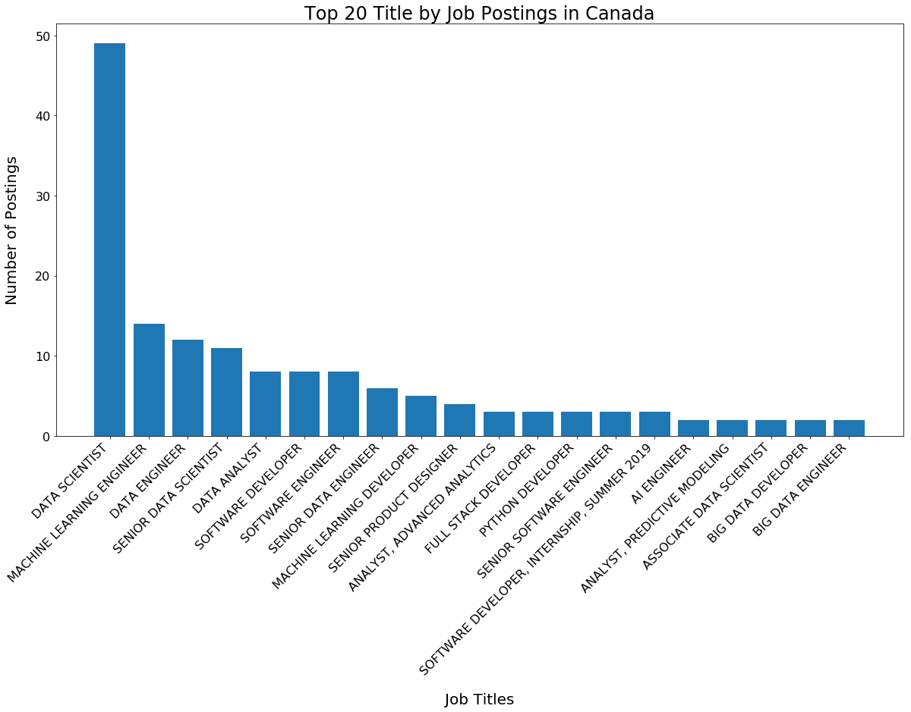
WHO ARE THE LOOKING FOR?
Data Scientists

Slide 13
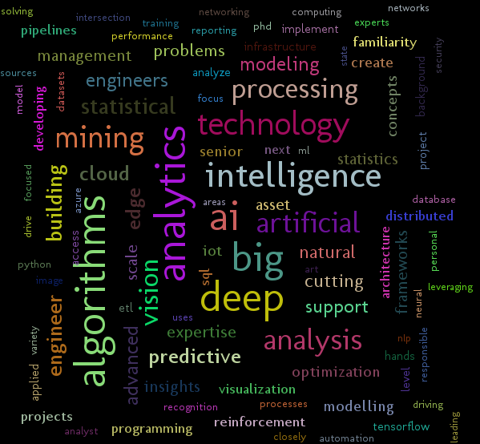
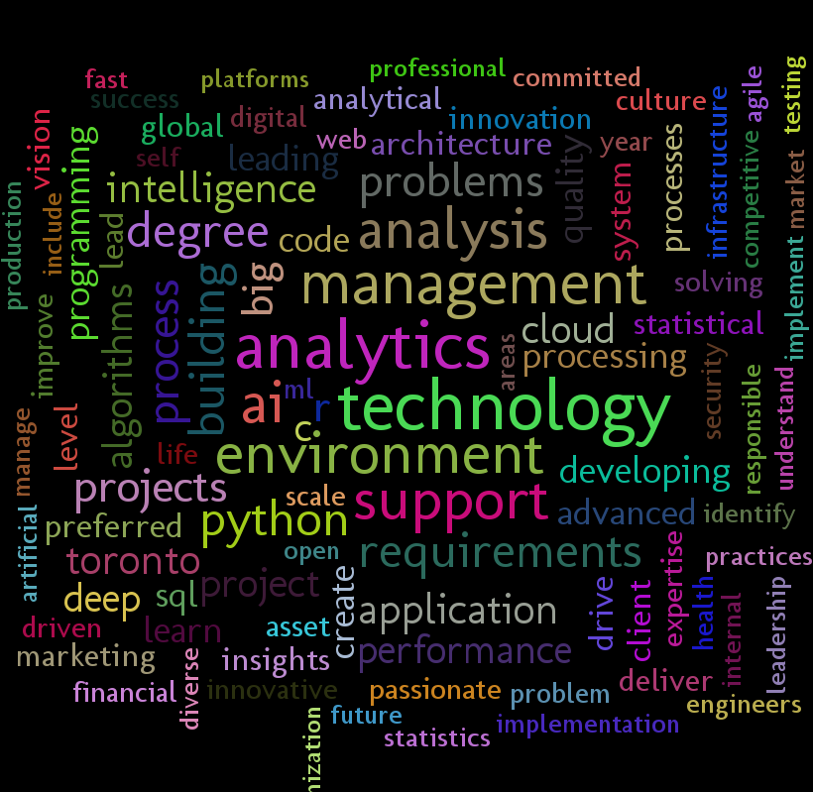
WHAT ARE THEY EXPECTING?
WordCloud from Job Summaries and Job Posting
Huawei Canada
Amazon Fulfillment Services
BMO Financial
RBC

Slide 14
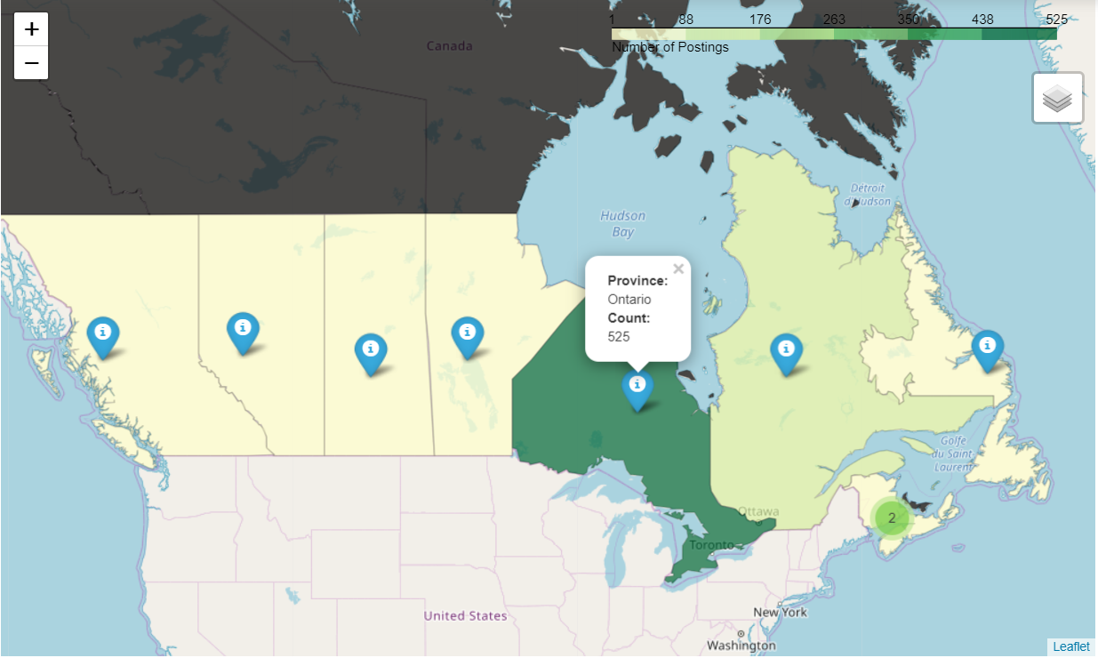
SOME GEOVISUALIZATION
GeoVisualization using Folium
Number of Job Postings by Province

Slide 15
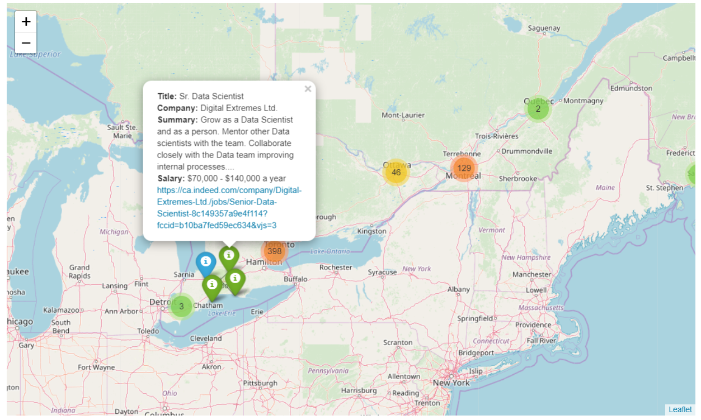
PUTTING IT ALL TOGETHER
Marker of Postings with Clustering

Slide 16
Conclusion
Where are all the data scientist jobs?
Toronto is the place to be
Who’s hiring?
Huawei Canada has the most job posting across Canada
What are they paying?
Not enough. Under 100K average across Canada. Go for openings at “The Alcer Group”
What are the qualifications?
Hard to tell. Lots of Programming. Statistics, Python, SQL, AI

Slide 17
References
https://python-visualization.github.io/folium/quickstart.html
https://towardsdatascience.com/scraping-job-posting-data-from-indeed-using-selenium-and-beautifulsoup-dfc86230baac
https://github.com/codeforamerica/click_that_hood/blob/master/public/data/canada.geojson
Lecture Notes

